Slide 1

My DH is <code/>.
Bryan Tarpley
Lead Software Applications Developer
TAMU IDHMC

Slide 2
DH Developer \\ My Path
B.A. in Computer Science
M.A. in English
10+ years experience in IT

Slide 3
DH Developer \\ Skillset
Open-source friendly programming languages [‘Python’, ‘Ruby’, ‘PHP’, ‘Java’, …]
Web oriented languages/standards [‘HTML’, ‘CSS’, ‘Javascript’, ‘XML’, ‘JSON’]
Text oriented standards [‘TEI’, ‘Page XML’, ‘hOCR’]
Acculturation in tech and the Humanities
Project collaboration

Slide 4
DH Developer \\ A Sample Project
The IDHMC offers a “Summer Technical Assistance Grant” to TAMU faculty
A faculty member was awarded this grant—they did archival work with a highly customized Book of Common Prayer from 1586 and wanted to record and analyze verse references, thematic tags, and affectual tags

Slide 5
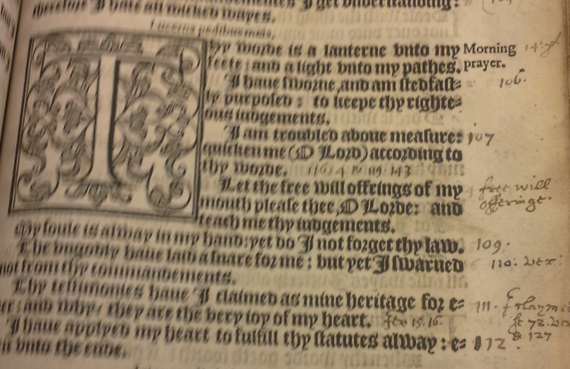
The Psalter Project

Slide 6
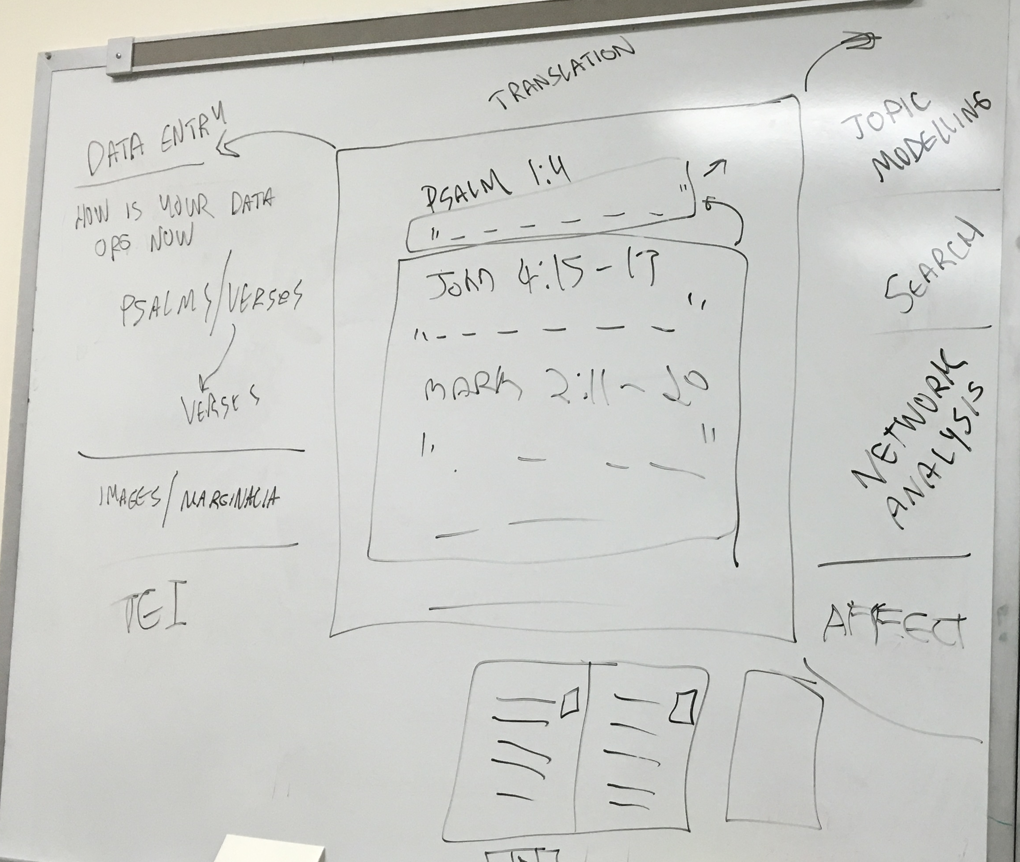
The Psalter Project

Slide 7
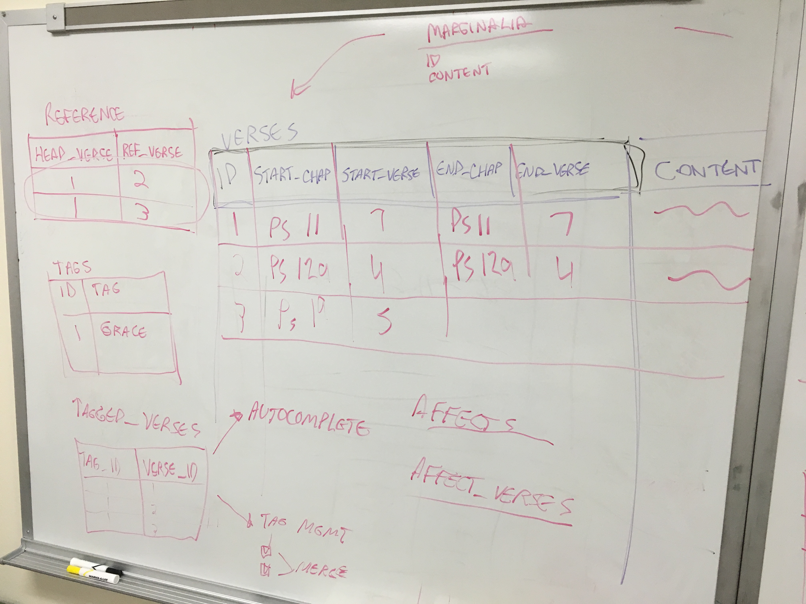
The Psalter Project

Slide 8
The Psalter Project

Slide 9
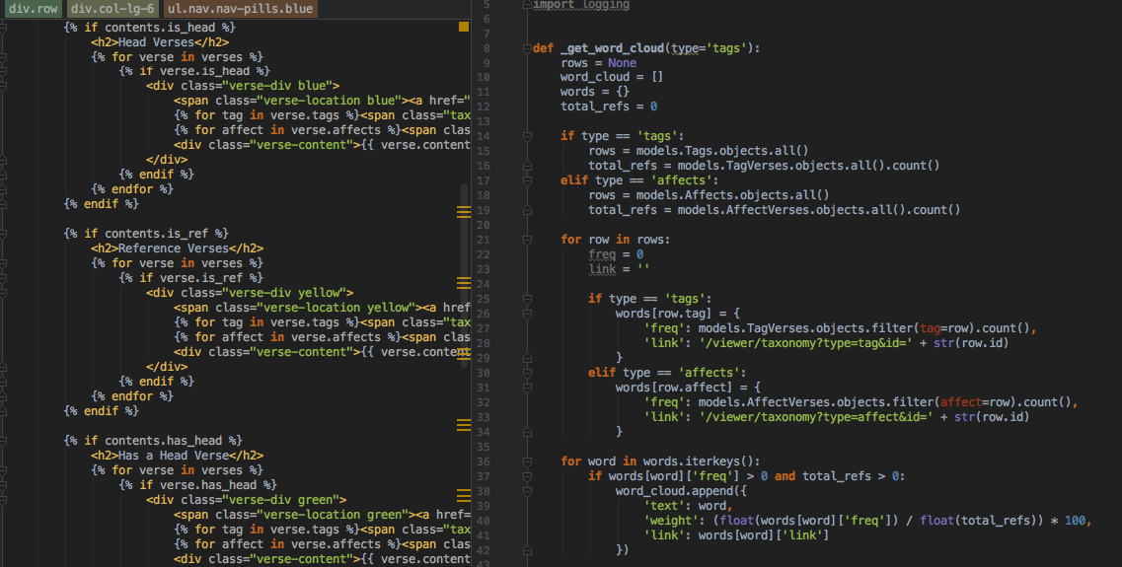
The Psalter Project

Slide 10
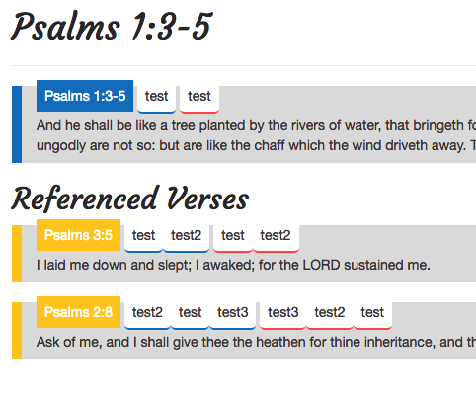
The Psalter Project

Slide 11

My DH is <code/>. Bryan Tarpley bptarpley@tamu.edu

